Slide 1
Class of 2024 ACT Data Analysis Critical Issues & Recommendations
By Ethan Villalobos

Slide 2
Introduction
Analyzing ACT data for the Class of 2024 to:
Identify factors affecting our goal of achieving a 21 average score across the district
Recommend areas of improvement that would add the most value toward the Class of 2025 hitting this goal

Slide 3
Data Analysis Approach
Preliminary analysis
basic statistical measures such as averages and performance comparison
Advanced analytical phase
machine learning techniques to
explore intricate relationships
quantify the impact of various factors

Slide 4
Data collection techniques
Basic Statistical Analytics
Python and basic math
Pandas, Numpy, Matplotlib
Averages
Identification of Critical Issues
High level understanding
Quick, less efficient improvements
Relationships are less nuanced
Machine Learning
Predictive analysis
Multi-linear regression
Predictions?
Accuracy
MSE, R squared (R2)
Visualization of residuals
Baseline comparison
Analysis
Coefficients
Quantify relationships of multiple factors

Slide 5
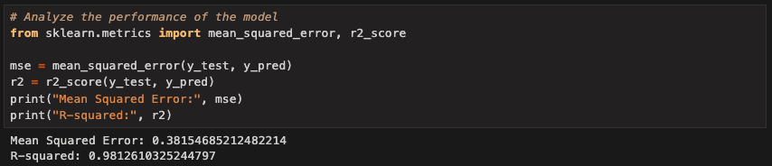

Slide 6
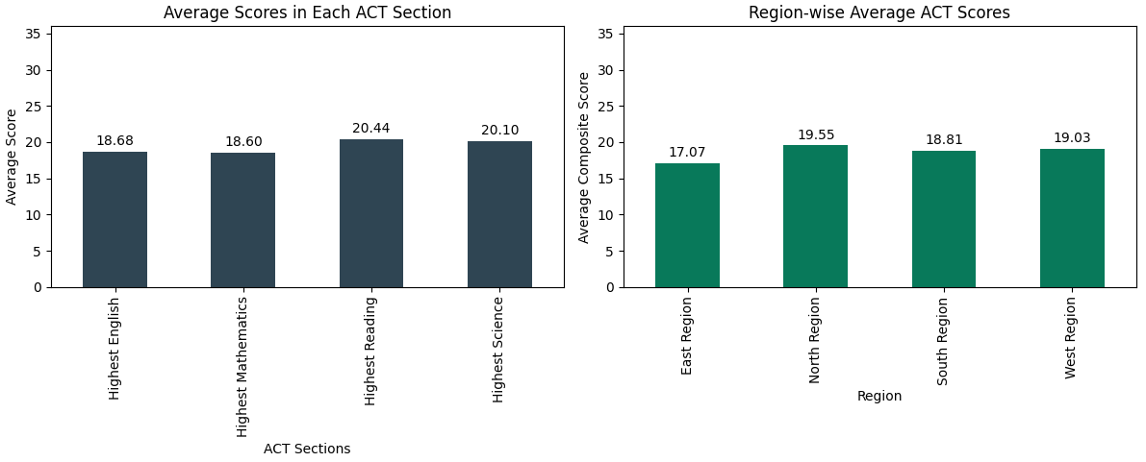
Preliminary Analysis

Slide 7
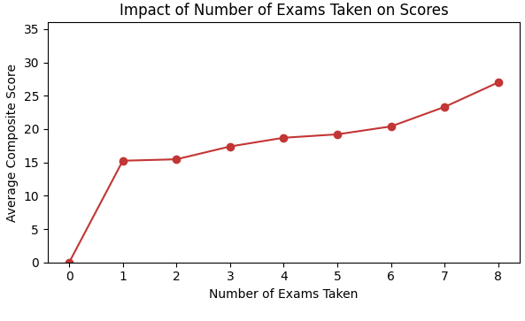
Preliminary Analysis Cont.

Slide 8
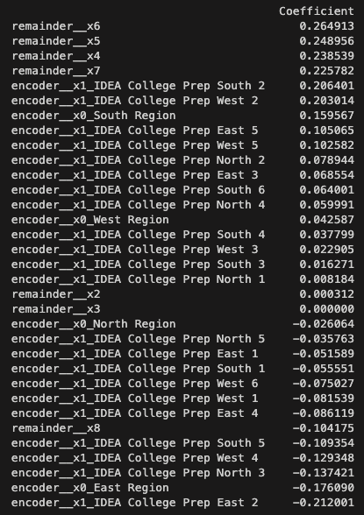
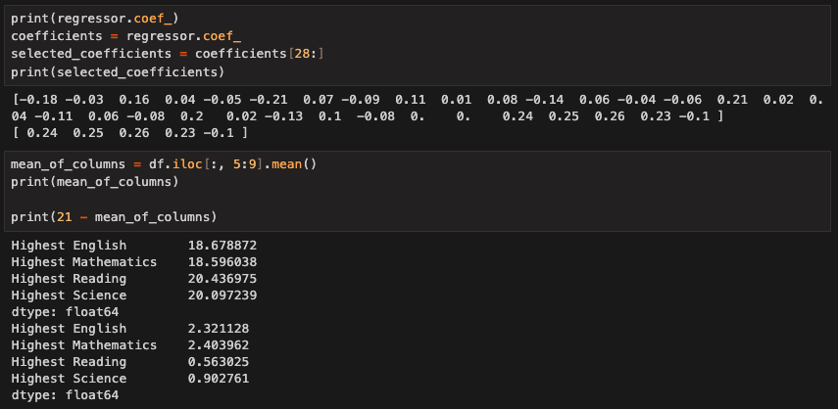

Slide 9
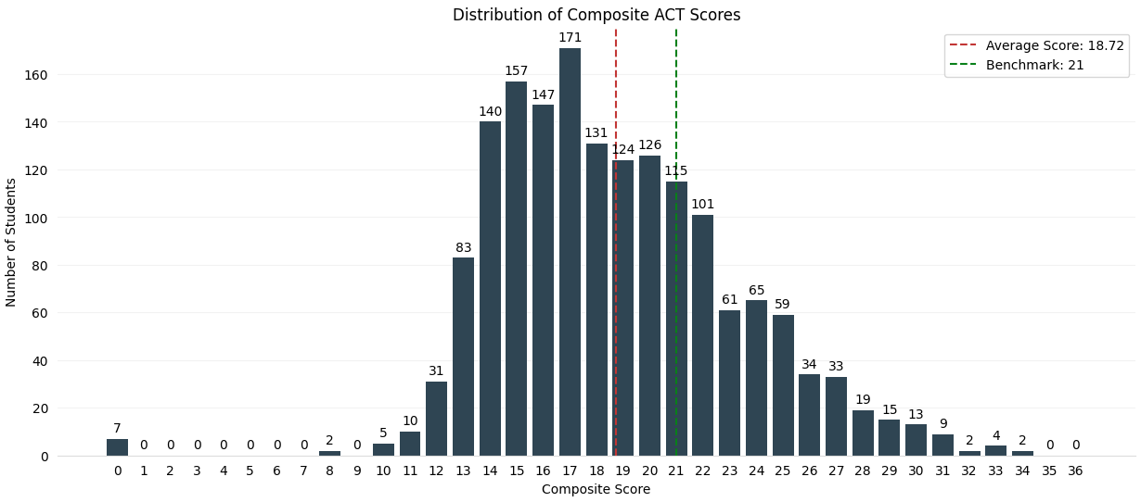
Advanced Analysis

Slide 10
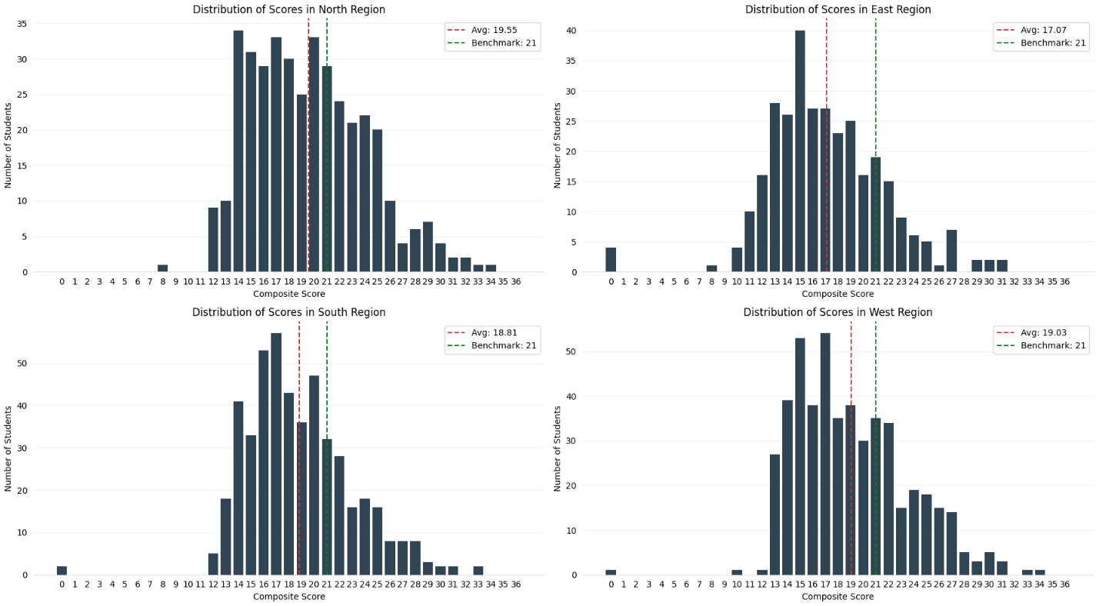

Slide 11
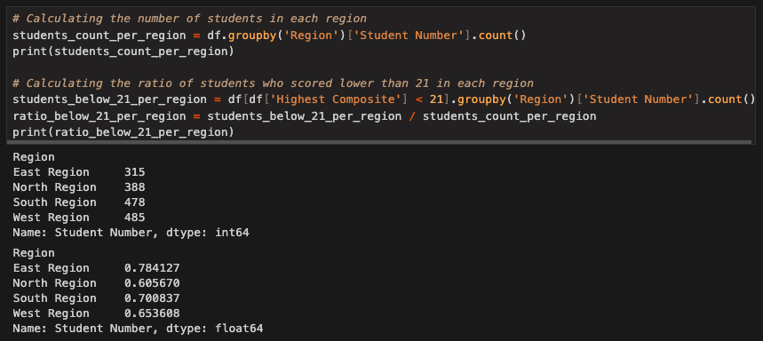

Slide 12
Critical Issues - Class of 2024
Is a uniform approach the most efficient way to reach our goal? Not necessarily.
Based on the data, here are the two most critical areas of attention:
Underperforming Schools and Regions
Subject-Specific Weaknesses

Slide 13
Recommendations - Class of 2025
Targeted support for underperforming schools
Implement tailored educational programs
Allocate additional resources
Focused enhancement in key subjects
Strengthen curriculum
Student oriented
English and Mathematics
Goal oriented
Reading and Mathematics
Conduct specialized workshops and sessions

Slide 14
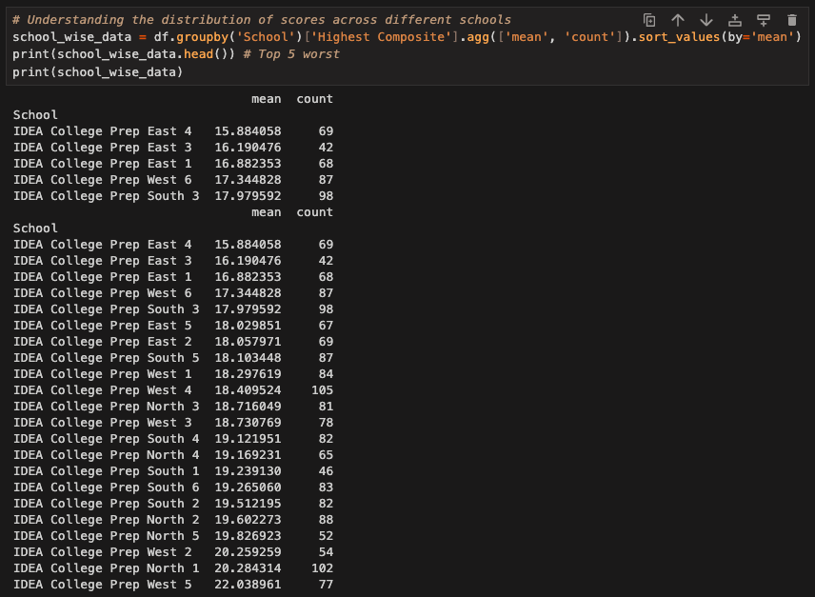

Slide 15
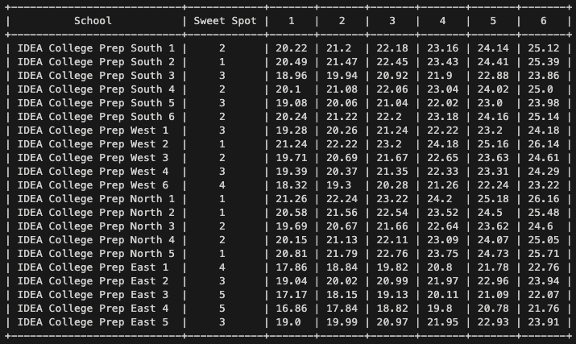

Slide 16
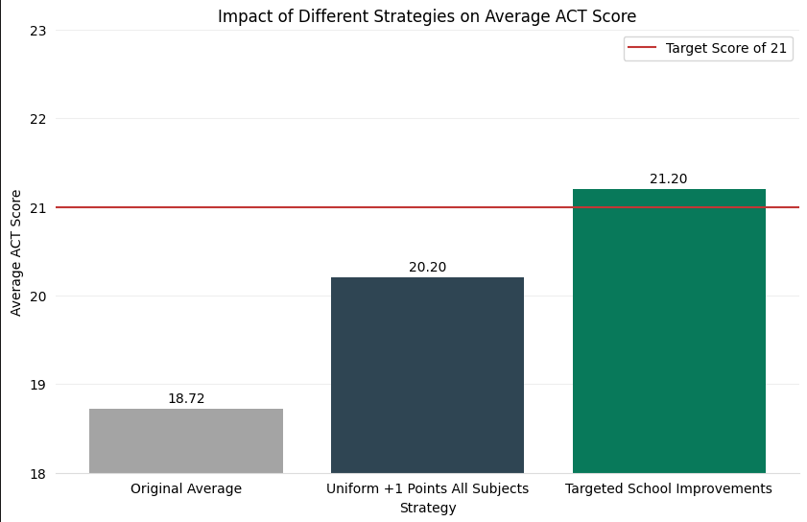

Slide 17
Questions?

Slide 18
Thank You!

